Slide 1
Health Literacy: Using the NHS and it’s services
Provided by:
Royal Berkshire NHS Foundation Trust
Berkshire Healthcare NHS Foundation Trust
Notes:
Good morning/afternoon
Introduce yourself.

Slide 2
What we are going to cover?
Icebreaker - Which service when
Seeing a doctor or nurse
Preparing for an appointment
Asking questions
Making decisions about treatment – Benefits, Risks, Alternative, Not doing anything (BRAN)
Medical jargon
Provided by:
Royal Berkshire NHS Foundation Trust
Berkshire Healthcare NHS Foundation Trust
Notes:
Today we are going to look at some practical skills you need when using the NHS and its services.
We are going to look at which service you use when
Look at the doctors appointment
Making decisions about treatment.

Slide 3
Icebreaker - Which service when?
You cut your finger. The cut looks deep and it won’t stop bleeding. What do you decide to do?
Ring your GP practice for an appointment
Call 999
Call 111
Provided by:
Royal Berkshire NHS Foundation Trust
Berkshire Healthcare NHS Foundation Trust
Notes:
You cut your finger. The cut looks deep and it won’t stop bleeding. What do you decide to do?
Vote or discussion as appropriate.
Answer:
Call 111 – they may be able to book an appointment at an urgent care or walk in centre.

Slide 4
Icebreaker - Which service when?
Your friend trips whilst playing football in the park and hurts their ankle. What do you decide to do?
Ring your GP practice for an appointment
Call 999
Call 111
Provided by:
Royal Berkshire NHS Foundation Trust
Berkshire Healthcare NHS Foundation Trust
Notes:
Your friend trips whilst playing football in the park and hurts their ankle. What do you decide to do?
Vote or discussion as appropriate.
Answer:
Call 999 – if it appears that the bone has broken,
Call 111 – if it is a sprain they may be able to book an appointment at an urgent care or walk in centre. If they suspect it is

Slide 5
Icebreaker - Which service when?
You are at a party and a friend has drunk too much and is unconscious. What do you decide to do?
Call 999
Call 111
Provided by:
Royal Berkshire NHS Foundation Trust
Berkshire Healthcare NHS Foundation Trust
Notes:
You are at a party and a friend has drunk too much and is unconscious. What do you decide to do?
Vote or discussion as appropriate.
Answer:
Call 999 – you should always dial 999 when it is a life threatening situation such as a stroke, heart attack or someone is unconscious
Call 111

Slide 6
NHS services
There are things that we can all do for ourselves and for one another to make sure resources are used appropriately and help the NHS work effectively.
Some injuries/illnesses can be treated by different NHS services. The service needed may also differ according to the seriousness of the symptoms or illness
If you are unsure or worried about a medical concern call 111 immediately.
’999’ should be called for an ambulance when it is life threatening. Or it is obvious that you or another person is seriously ill and in need of immediate emergency care.
Provided by:
Royal Berkshire NHS Foundation Trust
Berkshire Healthcare NHS Foundation Trust

Slide 7
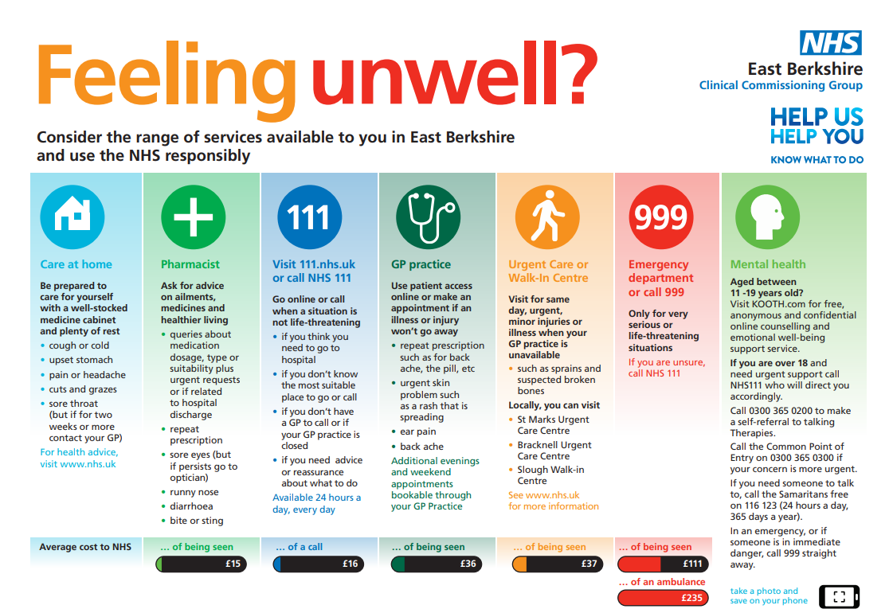
Notes:
Normally
The NHS provides lots of services and it can be confusing about where to go.
At home remember to care for yourself, have over the counter medication such as cough medicine, painkillers, plasters etc.
Pharmacists can provide advice and guidance on things like upset stomachs, hayfever, insect bites etc
111 provide help in a non life threatening situation. They give advice when you aren’t sure what to do and direct you to the correct service. They are also able to arrange an appointment with a GP out of hours, an urgent care centre and sometimes emergency department if required.
GP Practice is for routine health care for persistent symptoms or long term conditions. Appointments can be online, over the phone or face to face.
Urgent care and walk-in centres are for when you need urgent but not life threatening care. Such as for sprains, cuts, minor scalds and burns,
999 – call when someone is seriously ill or injured and their life is at risk. eg. loss of consciousness, chest pain, breathing difficulties, heart attack or stroke.
Emergency department – life threatening emergencies
At present the advice would be to call 111 unless it is a life threatening emergency as many urgent care and walk in centre require you to have an appointment.

Slide 8
Before a doctors appointment
Write down health problems you have had in the past or are experiencing now – your Health History
Know the medicines you take
Bring your family health history
Bring a list of things you want to talk about such as recent symptoms, drug side effects, or other general health questions
Provided by:
Royal Berkshire NHS Foundation Trust
Berkshire Healthcare NHS Foundation Trust
Notes:
When you go to the GP or to the hospital it is important to prepare a little:
Make a note of any health problems you have had in the past.
Know what medicines you already take,
know your family history,
take a list of what you want to talk about.
Think about what symptoms you have had, when did they start, how long have they been going on for,
Remember to take some paper and a pen so you can take notes. People often forget what their doctor has told them after they leave the surgery.

Slide 9
Before a doctor's appointment
Patients Association – Make the most of your GP appointment
https://www.patients-association.org.uk/make-the-most-of-your-gp-appointment
Doc Ready – tool to create a checklist for mental health appointments
http://www.docready.org/#/home
Provided by:
Royal Berkshire NHS Foundation Trust
Berkshire Healthcare NHS Foundation Trust
Notes:
The Patients Association have information about how to get the most out of your doctor’s appointment.
The Doc Ready tool is an online which can help create a checklist for appointments with a GP to discuss mental health issues.

Slide 10
What questions could you ask a doctor?
General questions
Questions about symptoms
Questions about treatments
Questions about tests
Provided by:
Royal Berkshire NHS Foundation Trust
Berkshire Healthcare NHS Foundation Trust
Notes:
You should always ask your GP questions. Evidence has shown that patients who are involved in their care and ask lots of questions have a better experience and outcomes.
When you look at what questions we might ask they fall into four areas.
General questions
Questions about symptoms
Questions about treatments
Questions about tests

Slide 11
What questions could you ask a doctor?
Have a think about what questions you might ask your doctor? Try and think of questions for each area.
General questions
Questions about symptoms
Questions about treatments
Questions about tests
Provided by:
Royal Berkshire NHS Foundation Trust
Berkshire Healthcare NHS Foundation Trust
Notes:
Have a think about what questions you might ask your gp?
An example would be what changes should I make to my lifestyle?

Slide 12
What questions could you ask a doctor?
General questions
What support is available for me?
Should I make changes to my lifestyle?
Where can I get more information?
Do you have any written information?
What happens next?
Questions about symptoms
What do my symptoms mean?
How long will they last?
What should I do if they get worse?
Provided by:
Royal Berkshire NHS Foundation Trust
Berkshire Healthcare NHS Foundation Trust
Notes:
General questions –
Symptom questions – like how long will they last, what should I do if they get worse

Slide 13
What questions could you ask a doctor?
Questions about treatments
What is the likely treatment?
How long will I need the treatment for?
Are there any side effects?
Will it interfere with other medication?
How will it fit in with my life?
Are there other options?
What happens if I do nothing?
When will they be reviewed?
What if I cannot cope?
Questions about tests
Do I need any tests?
When will they be done?
What will they involve?
Where will I have them done?
Will I need more tests after that?
How will I get the results?
What should I do if I do not get my results?
Provided by:
Royal Berkshire NHS Foundation Trust
Berkshire Healthcare NHS Foundation Trust
Notes:
Questions about treatments – these can be questions like how long should I take the treatment, what are the side effects, what are other options, where will I get referred for surgery
Questions about tests – these can be where do I need to go to have the tests, when will I get the results , how will I get the results.

Slide 14
Making decisions about treatment: BRAN
Remember the initials BRAN:
What are the benefits?
What the risks?
What are the alternatives?
What if I do nothing?
Provided by:
Royal Berkshire NHS Foundation Trust
Berkshire Healthcare NHS Foundation Trust
Notes:
Sometimes making decisions about your health can be difficult. You doctor or nurse are there to help you choose between treatment options. It can be useful remember the initial BRAN. Benefits, Risks, Alternatives, Nothing. You can use these to ask questions to help you make your decision

Slide 15
Benefits
What are the benefits of each treatment?
What are the chances each treatment will work?
Risks
How will the treatment affect me?
What are the possible side effects?
How will this treatment affect my lifestyle?
Alternatives
What are the other options open to me?
What are the benefits and disadvantages of those?
Could I try one if the first option does not work?
Nothing
What are the benefits if I choose to do nothing now?
What are the disadvantages if I do nothing now?
If I do not have treatment for now will the condition get worse?
Will it be more difficult to treat later?
Provided by:
Royal Berkshire NHS Foundation Trust
Berkshire Healthcare NHS Foundation Trust
Notes:
Benefits
What are the benefits of each treatment.? This could be length of treatment, number of times you need to take medication each day etc How does each treatment work?
Risks
What side effects are there?
Alternatives
Are there other medications I could take?
Could I try one thing and then try something else if it doesn’t work?
Nothing
If I did nothing what might happen?
Will it be more difficult to treat later.

Slide 16
Have you depurated your metacarpal phalanges today?
Try and work out what you think this might mean.
Provided by:
Royal Berkshire NHS Foundation Trust
Berkshire Healthcare NHS Foundation Trust

Slide 17
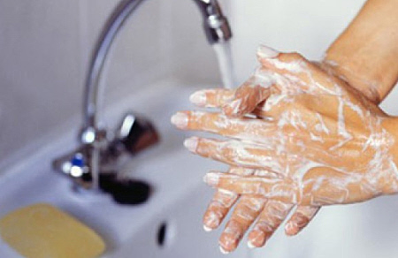
Have you washed your hands today?
Provided by:
Royal Berkshire NHS Foundation Trust
Berkshire Healthcare NHS Foundation Trust

Slide 18
What does it mean?
Benign
Hypertension
Anti-inflammatory
Hypotension
In-patient
Provided by:
Royal Berkshire NHS Foundation Trust
Berkshire Healthcare NHS Foundation Trust
Notes:
Discussion about what they think things mean. Add other terms if required.
Benign – not cancerous, Harmless; not cancer
Hypertension – high blood pressure
Hypotension – low blood pressure
Anti-inflammatory – reduce swelling
In-patient – someone who has to have treatment in hospital which requires an overnight stay

Slide 19
What does it mean?
Doctors and nurses often use jargon - often without meaning to or even noticing they are doing it.
If you don’t understand what your doctor is saying it’s best to ask at the time – but this can be tricky.
A good online medical dictionary can also help:
https://www.gosh.nhs.uk/conditions-and-treatments/health-dictionary/health-dictionary-a/
https://medical-dictionary.thefreedictionary.com/
Provided by:
Royal Berkshire NHS Foundation Trust
Berkshire Healthcare NHS Foundation Trust
Notes:
?Jargon is the specialised language of a particular profession – all professions have their jargon which outsiders won’t understand.
It can feel awkward to interrupt – but most hcps will be very happy to explain what they mean

Slide 20
Dr House
https://www.youtube.com/watch?v=nvwR74XpKUM
Provided by:
Royal Berkshire NHS Foundation Trust
Berkshire Healthcare NHS Foundation Trust

Slide 21
Helping people understand
Teach back
We’ve discussed a lot today, can you tell me what you found most important?
To check that I’ve explained everything properly, can you explain to me how you are going to take your medicines?
Just to make sure that my instructions make sense to you, can you tell me what are going to do next?
Further information can be found at teachback.org and Teach-back technique postcard
Provided by:
Royal Berkshire NHS Foundation Trust
Berkshire Healthcare NHS Foundation Trust
Notes:
So what do healthcare professionals do to help their patients understand their health information. Using teach back places the responsibility on the person giving the information, it focuses on a specific behaviour, allows for reassessment and the opportunity to explain again.
Teach back goes beyond asking “have you understood” or “is that explanation clear enough?” which encourages people to respond yes/no and people are more likely to say yes for fear of looking foolish.

Slide 22
Helping people understand
Chunk and check
Breaking down your information and check by using teach back
“Mrs Smith, we have had the recent results of your test and we need to adjust your dosage from 50mg to 75mg daily. Previously you had one tablet daily. Now you will have two tablets, a 50mg and a 25mg. When you get these from the pharmacy you will be given two different packets. To help you remember which is which you will see that that the strips containing the 50mg has a silver backing and the strips containing the 25mg a pink backing. These need to be taken in the morning at least 30 before food and 30 minutes before any caffeine containing drinks.”
Provided by:
Royal Berkshire NHS Foundation Trust
Berkshire Healthcare NHS Foundation Trust
Notes:
Chunk and check is another technique that can be used along with teach back. Let’s see what kind of information we normally get given when we go to the GP or consultant.
READ
That information dump above is enough to confuse me! It is worth knowing that it has been suggested that immediately after leaving the clinic, hospital, or GP patients forget 50% of the important information shared by the healthcare professional and only half of the remaining 50% is remembered correctly.
So by using chunk and check, each element is broken down and the patient to repeats back what they think they understand.
In pairs try breaking down the text into chunks and use teach back to check your partner has understood.

Slide 23
Provided by:
Royal Berkshire NHS Foundation Trust
Berkshire Healthcare NHS Foundation Trust

Slide 24
Summing up
Which service when
Seeing a doctor or nurse
Preparing for an appointment
Asking questions
Making decisions about treatment – Benefits, Risks, Alternative, Not doing anything (BRAN)
Medical jargon
But most importantly… be confident and ask questions.
Provided by:
Royal Berkshire NHS Foundation Trust
Berkshire Healthcare NHS Foundation Trust

